Slide 1
DATA STRUCTURES

Slide 2
Sorting Algorithms

Slide 3
OUTLINES
Introduction
Insertion Sort
Bubble Sort
Selection Sort
Merge sort
Quick Sort

Slide 4
SORTING
Sorting is the process of arranging the elements of an array so that they can be placed either in ascending or descending order.
For example, consider an array A = {A1, A2, A3, A4, ?? An }
Why Sorting Algorithms are Important
Since they can often reduce the complexity of a problem, sorting algorithms are very important in computer science. These algorithms have direct applications in searching algorithms, database algorithms, divide and conquer methods, data structure algorithms, and many more.
Notes:
목차
자바의 생성배경
자바를 사용하는 이유
과거, 현재, 미래의 자바
자바의 발전과정
버전별 JDK에 대한 설명
자바와 C++의 차이점
자바의 성능
자바 관련 산업(?)의 경향

Slide 5
SORTING (BUBBLE SORT)
What does bubble sort mean?
The name bubble sort comes from the fact that smaller or larger elements "bubble" to the top of a dataset. In the previous example of [3, 1, 4, 2], the 3 and 4 are bubbling up the dataset to find their proper positions.
This algorithm is alternatively called the sinking sort for the opposite reason; some of the elements are sinking to the bottom of the dataset. In our example, the 1 and the 2 are sinking elements

Slide 6
BUBBLE SORT
Bubble Sort is the simplest sorting algorithm that works by repeatedly swapping the adjacent elements if they are in the wrong order. This algorithm is not suitable for large data sets as its average and worst-case time complexity is quite high.

Slide 7
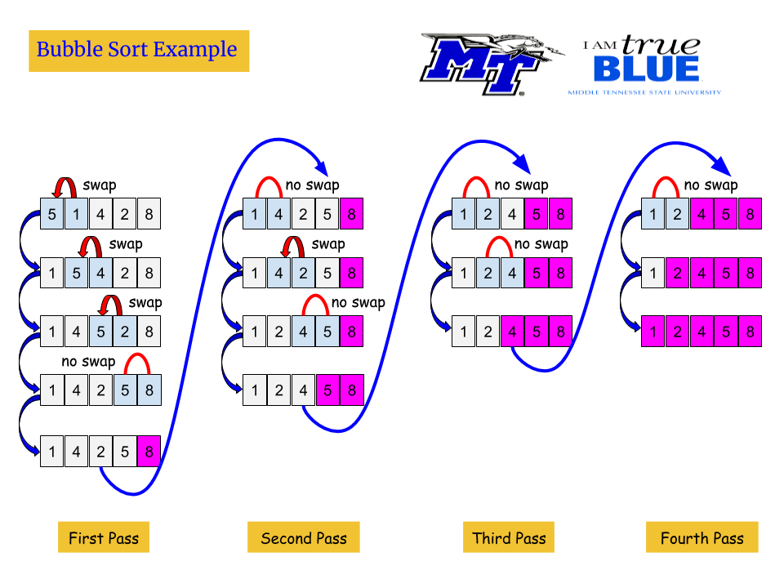

Slide 8
BUBBLE SORT ALGORITHM
BUBBLE_SORT(A, N)
Step 1: Repeat Step 2 For I= 0 to N-1
Step 2: Repeat step 3 For J =0 to N - I
Step 3: IF A[J] > A[J + 1]
SWAP A[J] and A[J+1]
[END OF INNER LOOP]
[END OF OUTER LOOP]
Step 4: EXIT
Notes:
목차
자바의 생성배경
자바를 사용하는 이유
과거, 현재, 미래의 자바
자바의 발전과정
버전별 JDK에 대한 설명
자바와 C++의 차이점
자바의 성능
자바 관련 산업(?)의 경향

Slide 9
INSERTION SORT

Slide 10
INSERTION SORT
Insertion sort works similar to the sorting of playing cards in hands. It is assumed that the first card is already sorted in the card game, and then we select an unsorted card. If the selected unsorted card is greater than the first card, it will be placed at the right side; otherwise, it will be placed at the left side. Similarly, all unsorted cards are taken and put in their exact place.
The same approach is applied in insertion sort. The idea behind the insertion sort is that first take one element, iterate it through the sorted array.

Slide 11
TECHNIQUE
Insertion sort works as follows:
The array of values to be sorted is divided into two sets. One that stores sorted values and another that contains unsorted values.
The sorting algorithm will proceed until there are elements in the unsorted set.
Suppose there are n elements in the array. Initially, the element with index 0 (assuming LB = 0) is in the sorted set. Rest of the elements are in the unsorted set.
The first element of the unsorted partition has array index 1 (if LB = 0).
During each iteration of the algorithm, the first element in the unsorted set is picked up and inserted into the correct position in the sorted set.

Slide 12
EXAMPLE OF INSERTION SORT
8
2
4
9
3
6

Slide 13
EXAMPLE OF INSERTION SORT
8
2
4
9
3
6

Slide 14
EXAMPLE OF INSERTION SORT
8
2
4
9
3
6
2
8
4
9
3
6

Slide 15
EXAMPLE OF INSERTION SORT
8
2
4
9
3
6
2
8
4
9
3
6

Slide 16
EXAMPLE OF INSERTION SORT
8
2
4
9
3
6
2
8
4
9
3
6
2
4
8
9
3
6

Slide 17
EXAMPLE OF INSERTION SORT
8
2
4
9
3
6
2
8
4
9
3
6
2
4
8
9
3
6

Slide 18
EXAMPLE OF INSERTION SORT
8
2
4
9
3
6
2
8
4
9
3
6
2
4
8
9
3
6
2
4
8
9
3
6

Slide 19
EXAMPLE OF INSERTION SORT
8
2
4
9
3
6
2
8
4
9
3
6
2
4
8
9
3
6
2
4
8
9
3
6

Slide 20
EXAMPLE OF INSERTION SORT
8
2
4
9
3
6
2
8
4
9
3
6
2
4
8
9
3
6
2
4
8
9
3
6
2
3
4
8
9
6

Slide 21
EXAMPLE OF INSERTION SORT
8
2
4
9
3
6
2
8
4
9
3
6
2
4
8
9
3
6
2
4
8
9
3
6
2
3
4
8
9
6

Slide 22
EXAMPLE OF INSERTION SORT
8
2
4
9
3
6
2
8
4
9
3
6
2
4
8
9
3
6
2
4
8
9
3
6
2
3
4
8
9
6
2
3
4
6
8
9
done

Slide 23
INSERTION SORT
INSERTION_SORT (A, N)
  INSERTION-SORT (ARR, N)
  Step 1: Repeat Steps 2 to 5 for i = 1 to N – 1
  Step 2: SET TEMP = ARR[i]
  Step 3: SET J = i – 1 //comparison
  Step 4: Repeat while (j>=0 && a[j] > temp)
  SET ARR[J + 1] = ARR[J]
  SET J = J - 1
  [END OF INNER LOOP]
  Step 5: SET ARR[J + 1] = TEMP
  [END OF LOOP]
  Step 6: EXIT

Slide 24
ADVANTAGES OF INSERTION SORT
The advantages of this sorting algorithm are as follows:
It is easy to implement and efficient to use on small sets of data.
It can be efficiently implemented on data sets that are already substantially sorted.
It performs better than algorithms like selection sort and bubble sort. Insertion sort algorithm is simpler than shell sort, with only a small trade-off in efficiency. It is over twice as fast as the bubble sort and almost 40 per cent faster than the selection sort.
It requires less memory space (only O(1) of additional memory space).
It is said to be online, as it can sort a list as and when it receives new elements

Slide 25
SELECTION SORT
This algorithm chooses the minimum element from the list of elements and swaps it with the first element of the list. Similarly, it chooses the second minimum element from the list and swaps it with the second element of the list. It continue swapping the elements until all the elements of the list are completely sorted in either direction.

Slide 26
How Does the Selection Sort Algorithm Work?
Selection sort works by taking the smallest element in an unsorted array and bringing it to the front. You’ll go through each item (from left to right) until you find the smallest one. The first item in the array is now sorted, while the rest of the array is unsorted

Slide 27
SELECTION SORT
5 | 1 | 3 | 4 | 6 | 2
Comparison
Data Movement
Sorted

Slide 28
SELECTION SORT
5 | 1 | 3 | 4 | 6 | 2
Comparison
Data Movement
Sorted

Slide 29
SELECTION SORT
5 | 1 | 3 | 4 | 6 | 2
Comparison
Data Movement
Sorted

Slide 30
SELECTION SORT
5 | 1 | 3 | 4 | 6 | 2
Comparison
Data Movement
Sorted

Slide 31
SELECTION SORT
5 | 1 | 3 | 4 | 6 | 2
Comparison
Data Movement
Sorted

Slide 32
SELECTION SORT
5 | 1 | 3 | 4 | 6 | 2
Comparison
Data Movement
Sorted

Slide 33
SELECTION SORT
5 | 1 | 3 | 4 | 6 | 2
Comparison
Data Movement
Sorted

Slide 34
SELECTION SORT
5 | 1 | 3 | 4 | 6 | 2
•
Min
Comparison
Data Movement
Sorted

Slide 35
SELECTION SORT
1 | 5 | 3 | 4 | 6 | 2
Comparison
Data Movement
Sorted

Slide 36
SELECTION SORT
1 | 5 | 3 | 4 | 6 | 2
Comparison
Data Movement
Sorted

Slide 37
SELECTION SORT
1 | 5 | 3 | 4 | 6 | 2
Comparison
Data Movement
Sorted

Slide 38
SELECTION SORT
1 | 5 | 3 | 4 | 6 | 2
Comparison
Data Movement
Sorted

Slide 39
SELECTION SORT
1 | 5 | 3 | 4 | 6 | 2
Comparison
Data Movement
Sorted

Slide 40
SELECTION SORT
1 | 5 | 3 | 4 | 6 | 2
•
Min
Comparison
Data Movement
Sorted

Slide 41
SELECTION SORT
1 | 2 | 3 | 4 | 6 | 5
Comparison
Data Movement
Sorted

Slide 42
SELECTION SORT
1 | 2 | 3 | 4 | 6 | 5
Comparison
Data Movement
Sorted

Slide 43
SELECTION SORT
1 | 2 | 3 | 4 | 6 | 5
Comparison
Data Movement
Sorted

Slide 44
SELECTION SORT
1 | 2 | 3 | 4 | 6 | 5
Comparison
Data Movement
Sorted

Slide 45
SELECTION SORT
1 | 2 | 3 | 4 | 6 | 5
Comparison
Data Movement
Sorted

Slide 46
SELECTION SORT
1 | 2 | 3 | 4 | 6 | 5
•
Min
Comparison
Data Movement
Sorted

Slide 47
SELECTION SORT
1 | 2 | 3 | 4 | 6 | 5
Comparison
Data Movement
Sorted

Slide 48
SELECTION SORT
1 | 2 | 3 | 4 | 6 | 5
Comparison
Data Movement
Sorted

Slide 49
SELECTION SORT
1 | 2 | 3 | 4 | 6 | 5
Comparison
Data Movement
Sorted

Slide 50
SELECTION SORT
1 | 2 | 3 | 4 | 6 | 5
•
Min
Comparison
Data Movement
Sorted

Slide 51
SELECTION SORT
1 | 2 | 3 | 4 | 6 | 5
Comparison
Data Movement
Sorted

Slide 52
SELECTION SORT
1 | 2 | 3 | 4 | 6 | 5
Comparison
Data Movement
Sorted

Slide 53
SELECTION SORT
1 | 2 | 3 | 4 | 6 | 5
Comparison
Data Movement
Sorted

Slide 54
SELECTION SORT
1 | 2 | 3 | 4 | 6 | 5
•
Min
Comparison
Data Movement
Sorted

Slide 55
SELECTION SORT
1 | 2 | 3 | 4 | 5 | 6
Comparison
Data Movement
Sorted

Slide 56
SELECTION SORT
1 | 2 | 3 | 4 | 5 | 6
DONE!
Comparison
Data Movement
Sorted

Slide 57
Divide and Conquer
Recursive in structure
  Divide the problem into sub-problems that are similar to the original but smaller in size
  Conquer the sub-problems by solving them recursively. If they are small enough, just solve them in a straightforward manner.
  Combine the solutions to create a solution to the original problem

Slide 58
An Example: Merge Sort
Sorting Problem: Sort a sequence of n elements into non-decreasing order.
Divide: Divide the n-element sequence to be sorted into two subsequences of n/2 elements each
Conquer: Sort the two subsequences recursively using merge sort.
Combine: Merge the two sorted subsequences to produce the sorted answer.

Slide 59
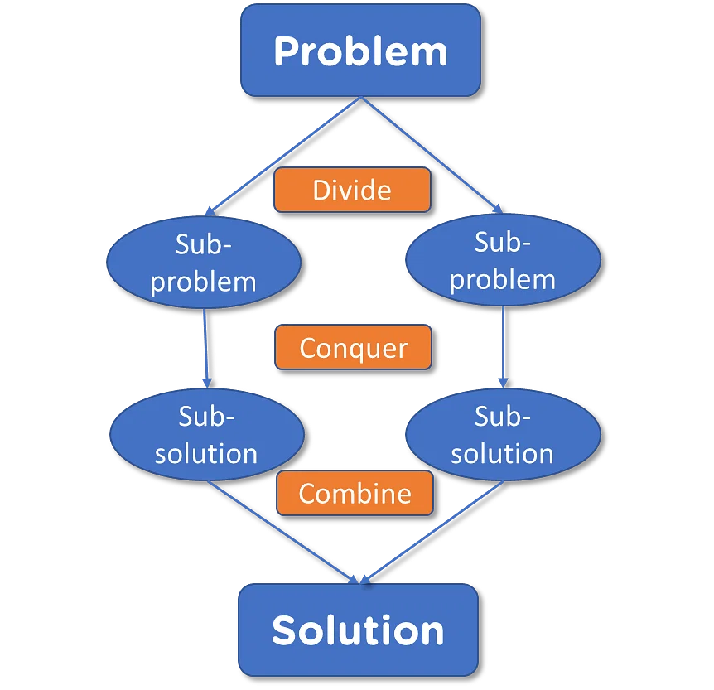

Slide 60
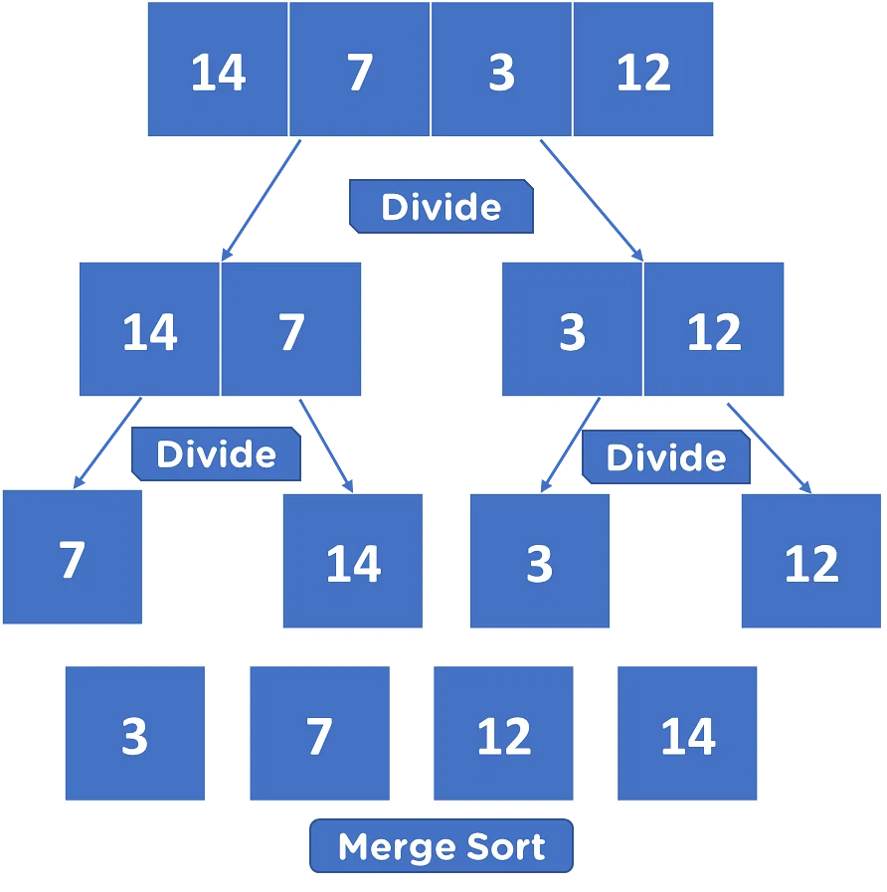

Slide 61
Merge Sort – Example
18
26
32
6
43
15
9
1
22
26
19
55
37
43
99
2
18
26
32
6
43
15
9
1
22
26
19
55
37
43
99
2
18
26
32
6
43
15
9
1
22
26
19
55
37
43
99
2
18
26
32
6
43
15
9
1
22
26
19
55
37
43
99
2
18
26
32
6
43
15
9
1
22
26
19
55
37
43
99
2

Slide 62
Merge Sort – Example
Original Sequence
Sorted Sequence
18
26
32
6
43
15
9
1
18
26
32
6
43
15
9
1
1
6
9
15
18
26
32
43
18
26
32
6
43
15
9
1
18
26
32
6
43
15
9
1
6
26
32
6
18
26
32
18
1
9
15
43
1
9
15
43
18
26
43
15
9
1
18
26
32
6
43
15
9
1
32
6
18
26
6
32
15
43
18
26
6
32
15
43
1
9
1
9
18
26
32
15
1
15
18
26
32
6
43
15
9
1
18
26
6
43
9
26
32
6
43
15
9
9
1
18
32
6
43
1
18
26
32
6
43
15
9
1
18
26
32
6
43
15
9
1

Slide 63
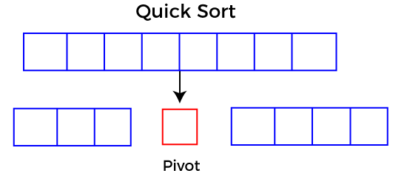
Quick Sort Algorithm
Quicksort picks an element as pivot, and then it partitions the given array around the picked pivot element. In quick sort, a large array is divided into two arrays in which one holds values that are smaller than the specified value (Pivot), and another array holds the values that are greater than the pivot.
After that, left and right sub-arrays are also partitioned using the same approach. It will continue until the single element remains in the sub-array.

Slide 64
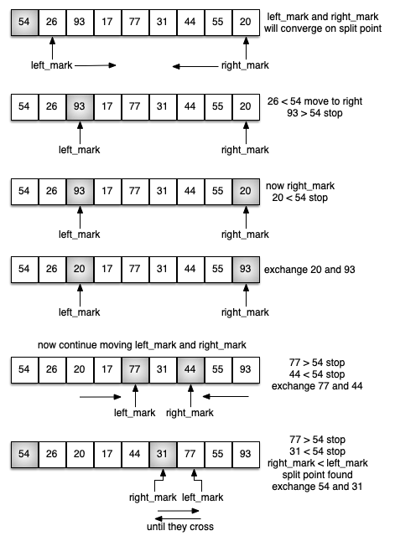
EXAMPLE:

Slide 65
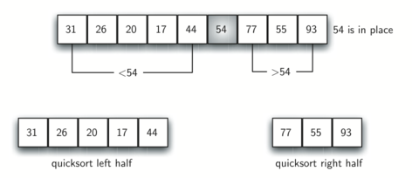

Slide 66
Pseudo-code quick Sort
function quickSort(arr, l, r)
if l < r
pivotIndex = partition(arr, l, r)
quickSort(arr, l, pivotIndex - 1)
quickSort(arr, pivotIndex + 1, r)
function partition(arr, l, r)
pivot = arr[r]
i = l - 1
for j = l to r - 1
if arr[j] < pivot
i = i + 1
swap arr[i] and arr[j]
swap arr[i + 1] and arr[r]
return i + 1

Slide 67
RECURSIVE ALGORITHM
function partitionFunc(left, right, pivot)
leftPointer = left
rightPointer = right - 1
while True do
while A[++leftPointer] < pivot do
//do-nothing
end while
while rightPointer > 0 && A[--rightPointer] > pivot do
//do-nothing
end while
if leftPointer >= rightPointer
break
else
swap leftPointer,rightPointer
end if
end while
swap leftPointer,right
return leftPointer
end function

Slide 68

Questions?
Notes:
목차
자바의 생성배경
자바를 사용하는 이유
과거, 현재, 미래의 자바
자바의 발전과정
버전별 JDK에 대한 설명
자바와 C++의 차이점
자바의 성능
자바 관련 산업(?)의 경향

Slide 69


